Slide 1
Citizen infrastructure: the things network
Building an open and free Internet of Things network
Gonzalo Casas
casas@arch.ethz.ch | @gnz

Slide 2
Smart
CITIES?
Notes:
Was asked -> What are smart cities?

Slide 3

Photo by hub.beesmart.city
Smart
CITIES?
Notes:
NOT THIS: dystopian “Minority report” style top-down strategies

Slide 4
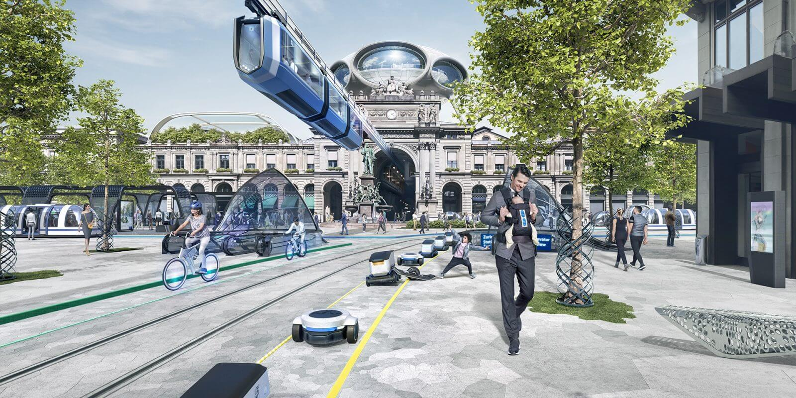
Photo by Julius Bär
Smart
CITIES?
Notes:
Also NOT this.

Slide 5
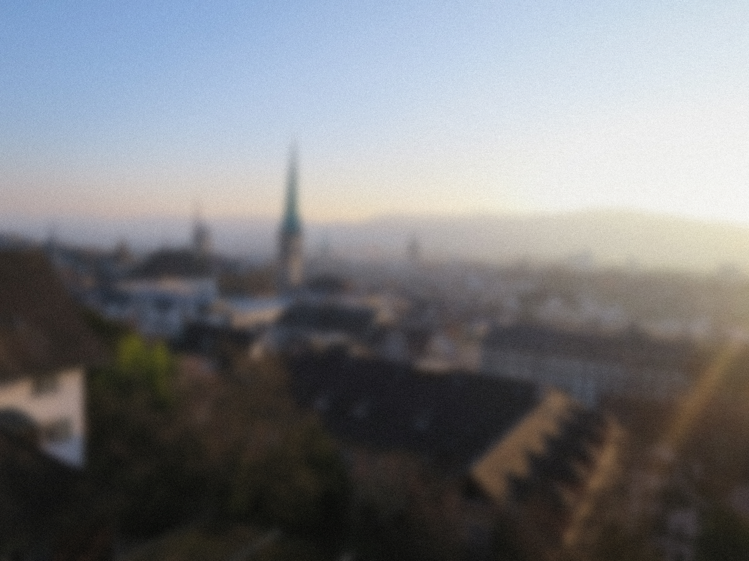
Collective
Intelligence
Notes:
Smart city = one that leverages the collective intelligence of its inhabitants.
Two heads are better than one (aka community is greater than the sum of its parts) => 400K + common goals = great results

Slide 6


Slide 7
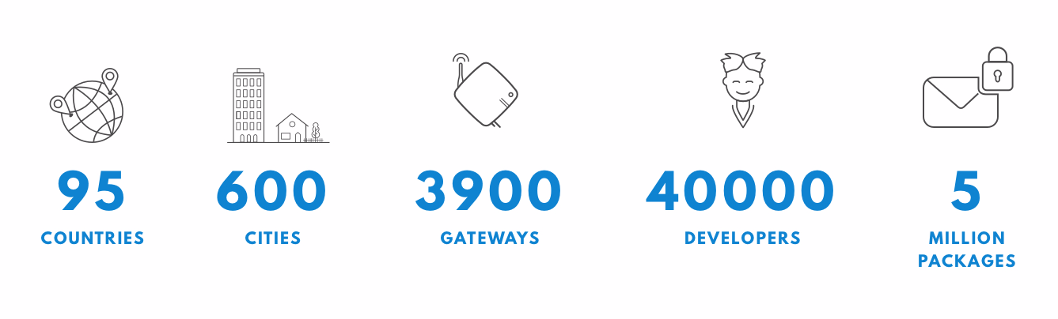
The Things Network
A global community, building open source to operate a crowd-sourced network for the Internet of Things.
Notes:
Started in 2015.
Now The Things Network is active in more than 600 cities across more than 90 countries (and 40k+ members)
USING LoRaWAN

Slide 8
The Things Network
A global community, building open source to operate a crowd-sourced network for the Internet of Things.
GLOBAL
FREE/OPEN
WIFI
SENSORS
Notes:
Started in 2015.
Now The Things Network is active in more than 600 cities across more than 90 countries (and 40k+ members)

Slide 9

Notes:
How do you provide “wifi” coverage to whole city as a community?

Slide 10
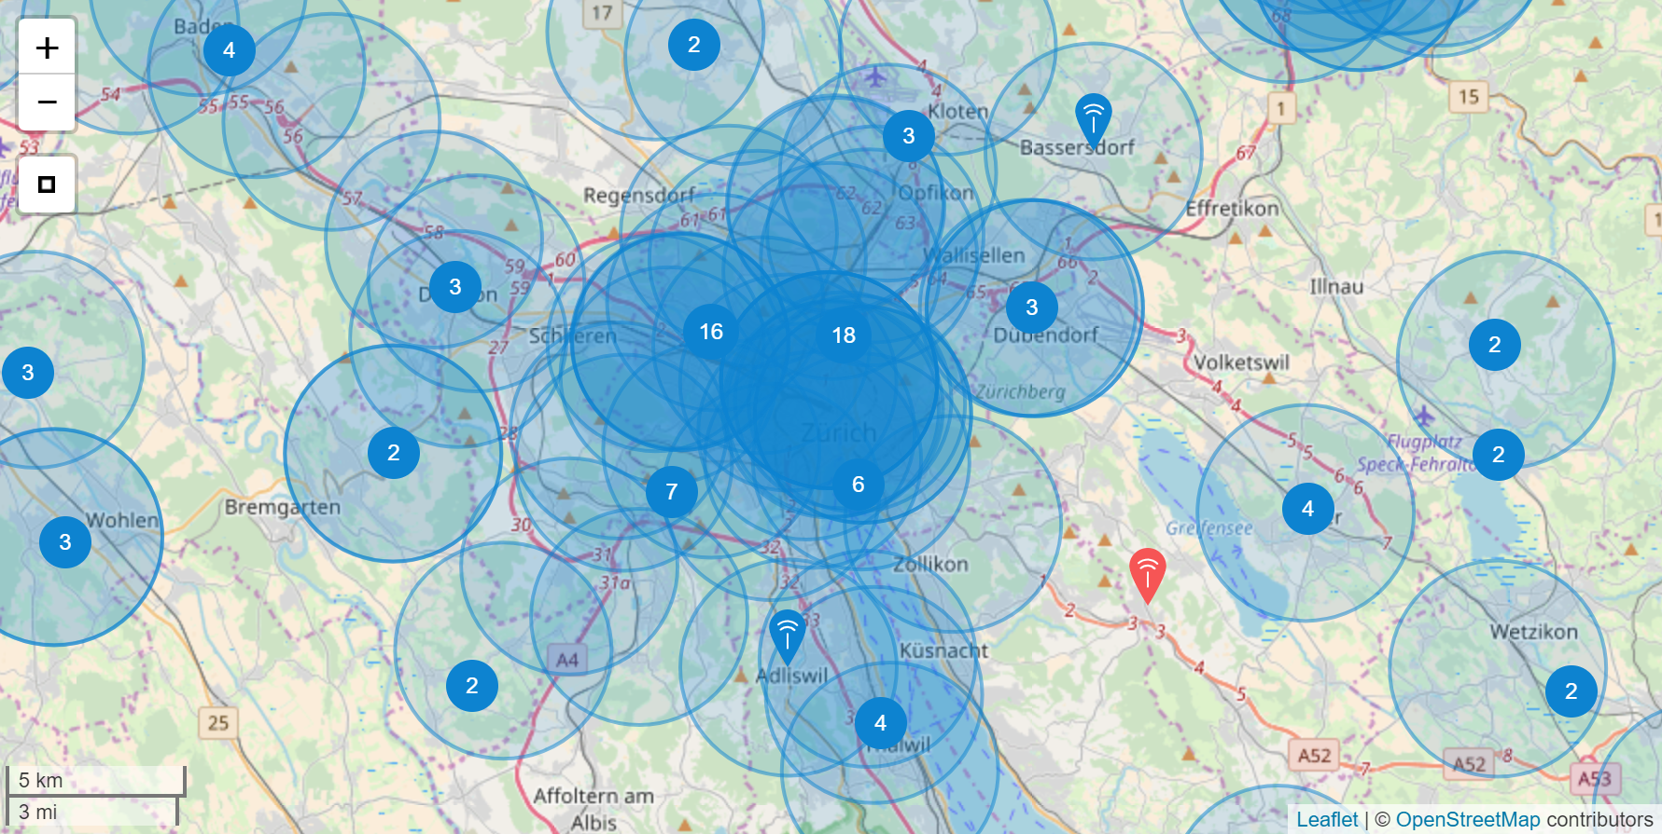
Zurich coverage
Notes:
Coverage now. CROWD-SOURCED, no telco.
This means, you can go out right now, and make a sensor that connects to the internet, for free, no strings attached.

Slide 11
LoRaWAN
10 km range
3 * 10
10 USD/node
10 years battery life
Notes:
Enabled by technology + community. Bottom-up / citizen infrastructure.

Slide 12

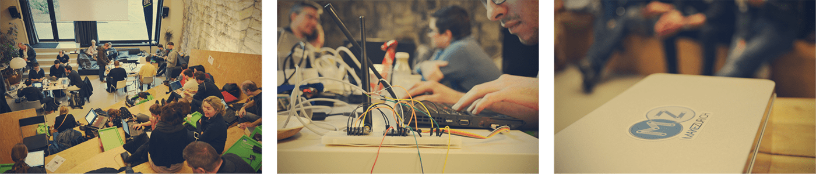
Civic tech and LoRaWAN maker days for a better city
KICK-OFF
Kraftwerk
Maker days
JUNE 22
JUNE 29-30
Notes:
If you are curious -> Join MakeZurich! Stop talking about smart cities, and start making them.

Slide 13
THANKS!
Gonzalo Casas
casas@arch.ethz.ch | @gnz

Slide 14
WHAT IS LoRaWAN?
Notes:
So, what do we do in concrete terms? We’re deploying an IoT network based on a technology called LoRaWAN.
How many know about LoRaWAN already? Raise your hand.
How many have played with it already?

Slide 15






LoRaWAN
LoRa (Long Range): Radio modulation technique
LoRaWAN: MAC protocol for Wide Area Networks (OSI Layer 2 and 3)
LoRa
ip
ip
sensors
nodes
gateways
backend
application
backend
Notes:
Media Access Control protocol for wide area networks.
LoRaWAN networks are star of starts and
the 4 main components are: sensor + gw + loraback backend + app backend.

Slide 16
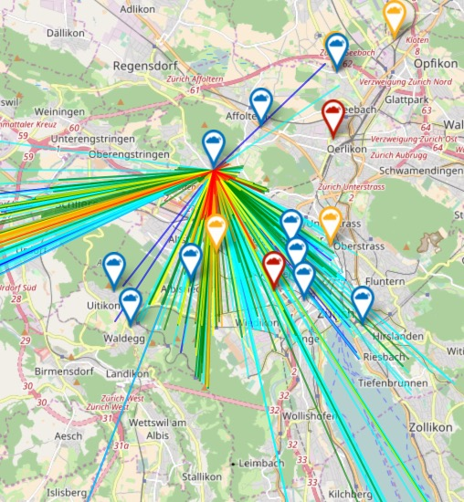
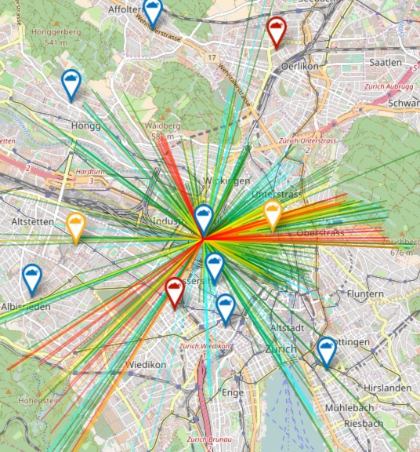
Long range
© ttnmapper.org , Open Street Map
2km - 5km in urban setting
40km+ in rural setting

Slide 17
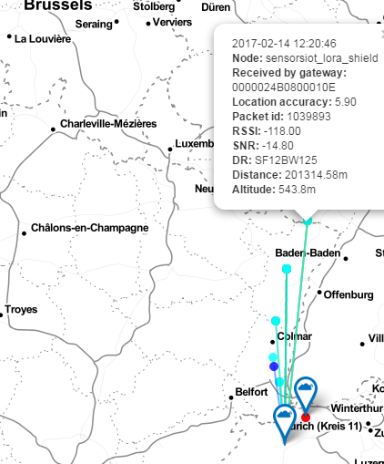
INSANELY
Long range
© ttnmapper.org
(under extreme conditions)
201 km ground-to-ground
by Andreas Spiess, TTN Basel
http://www.sensorsiot.org/

Slide 18
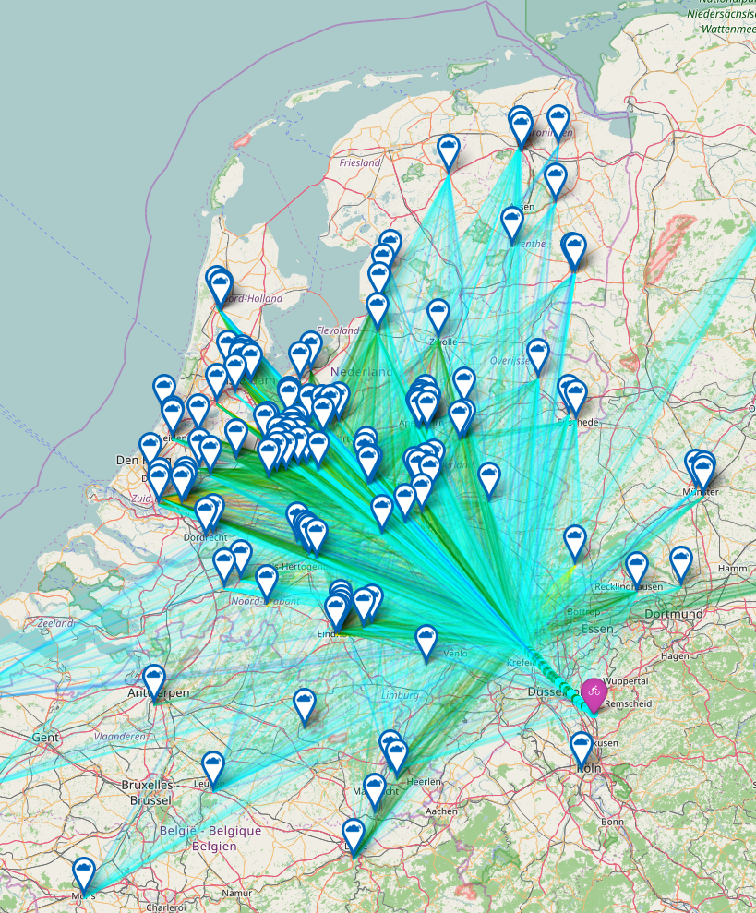
INSANELY
Long range
© ttnmapper.org
(under extreme conditions)
333 km air-to-ground (helium balloon)
by @telkamp (mapping @jpmeijers)

Slide 19
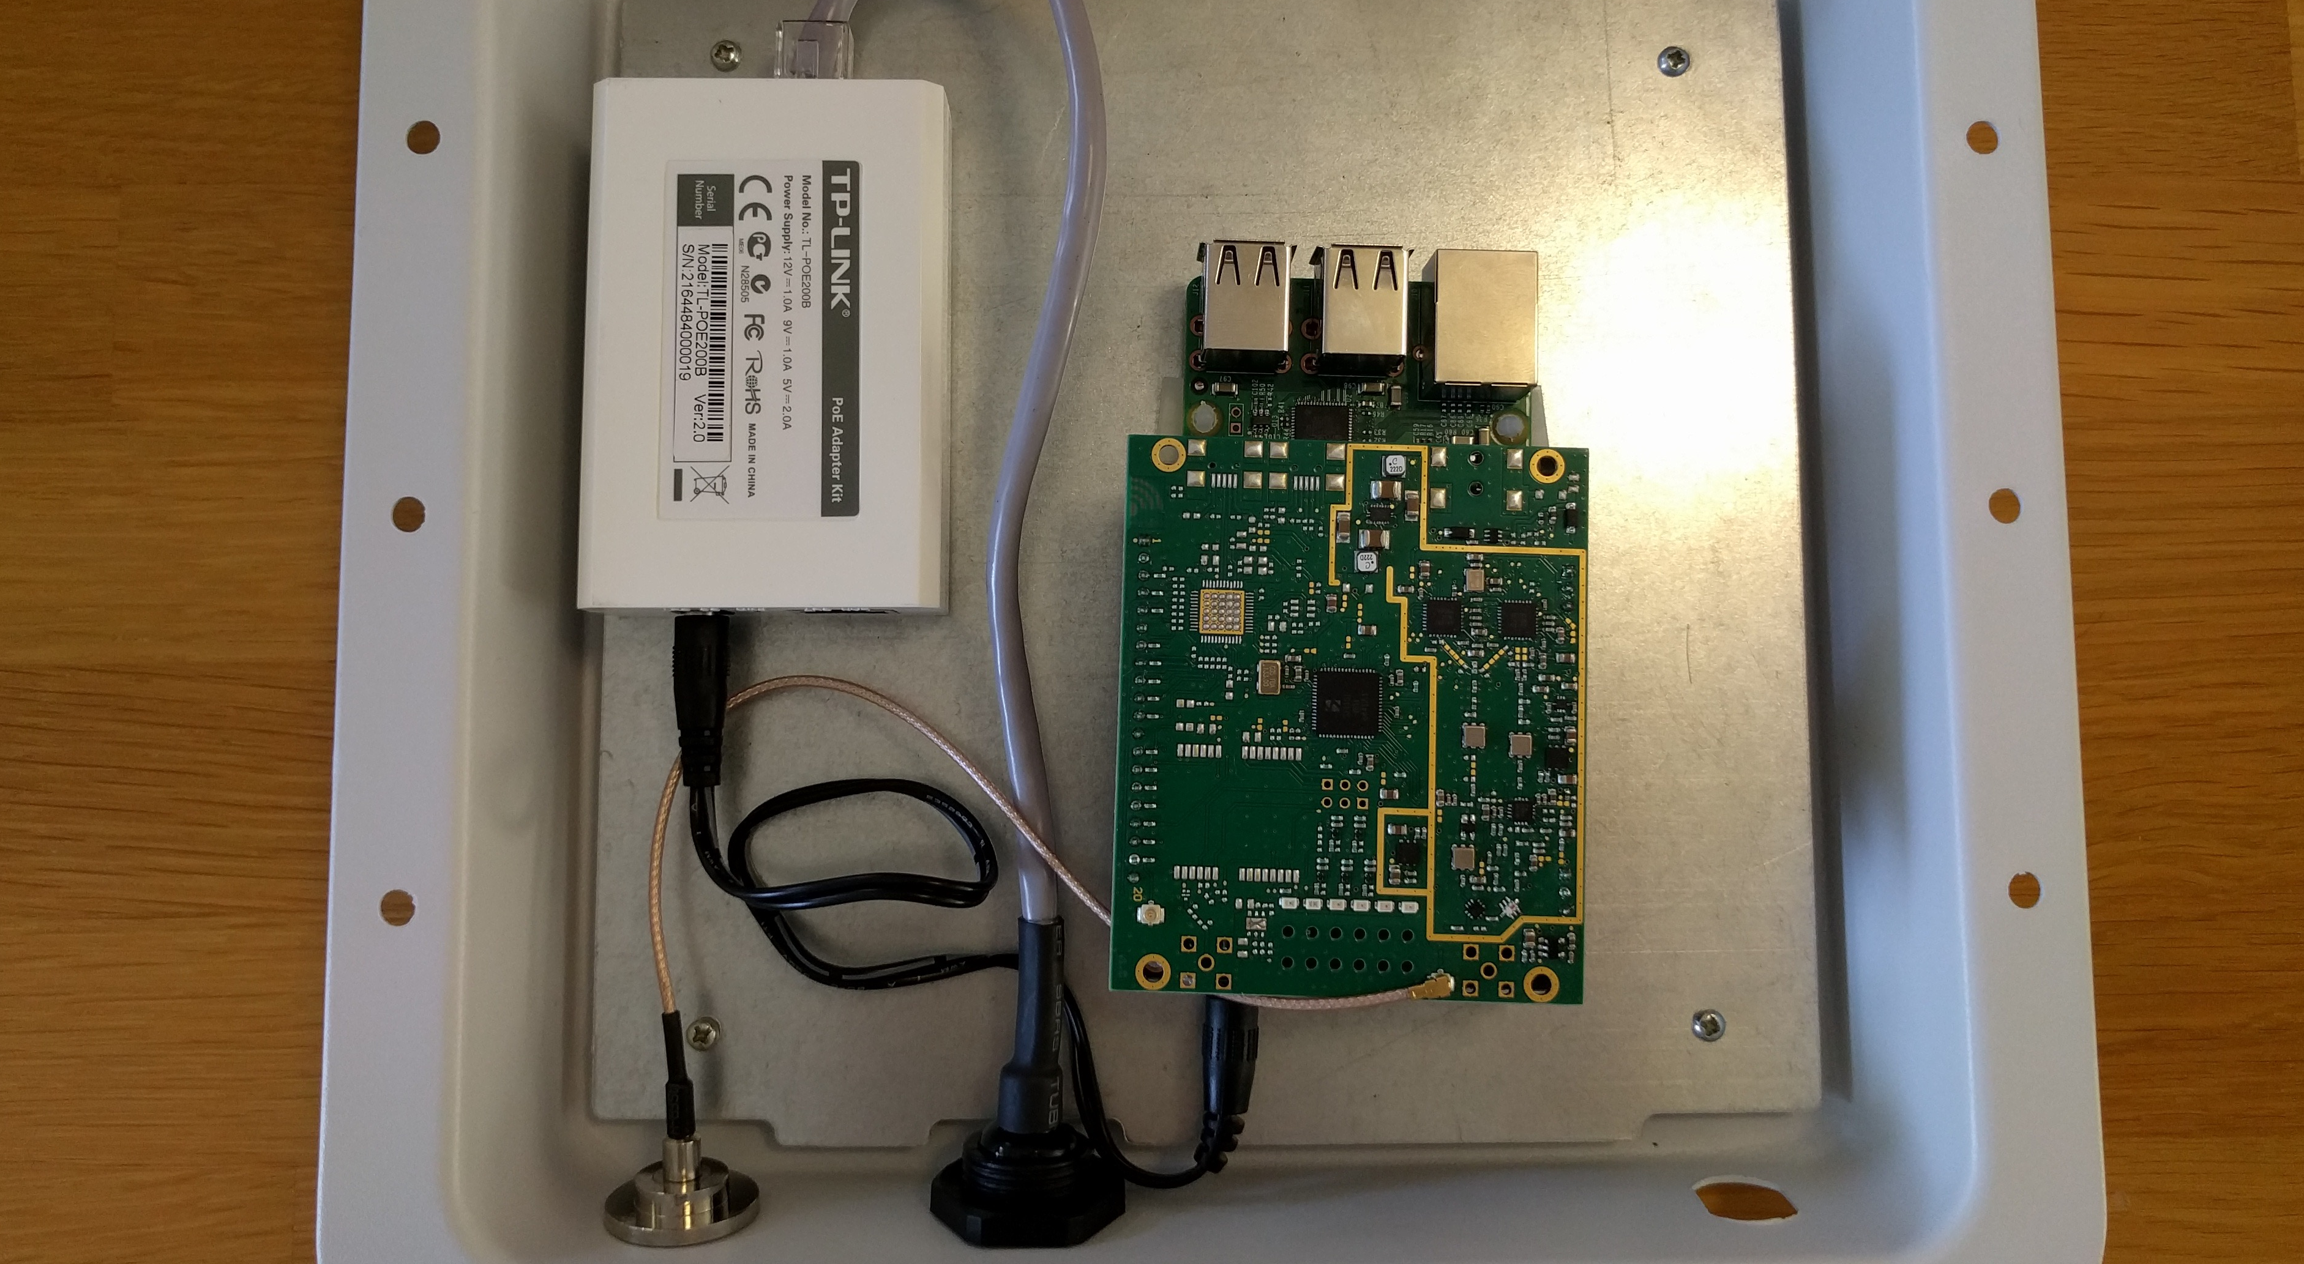
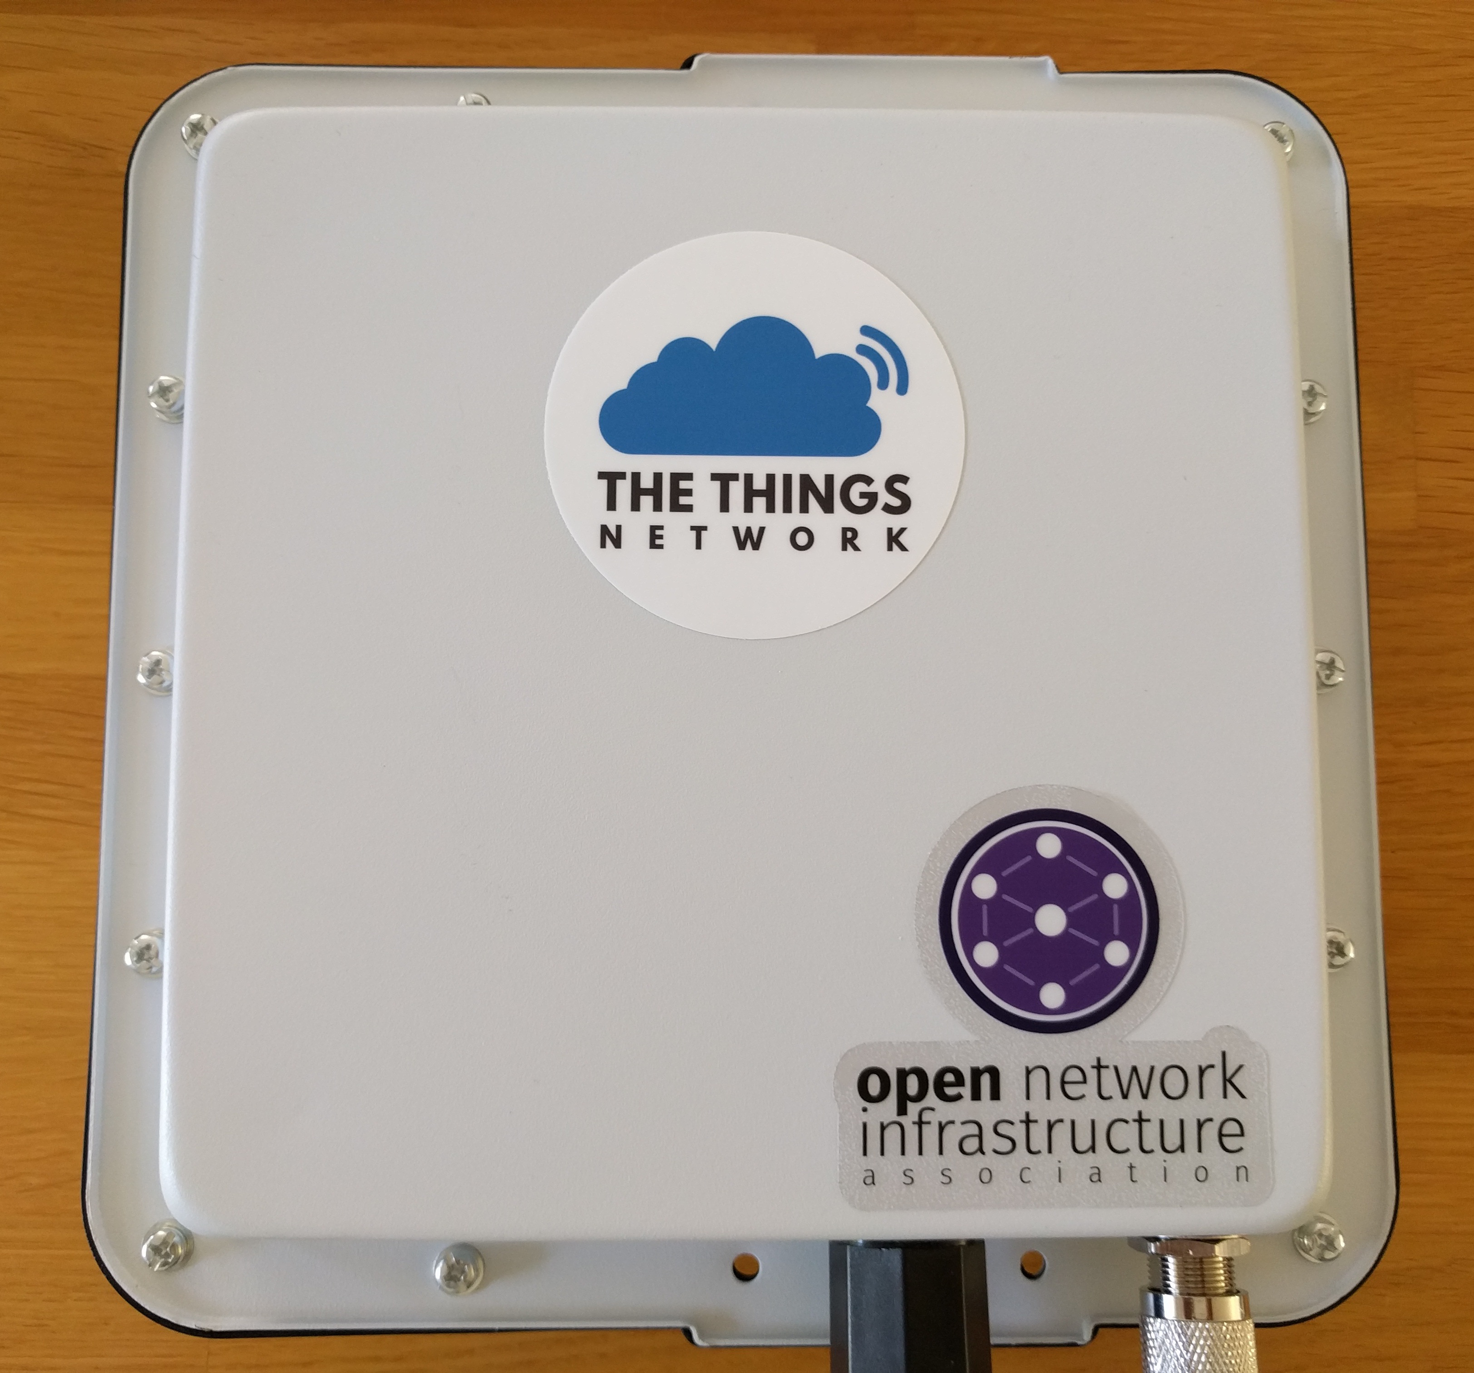
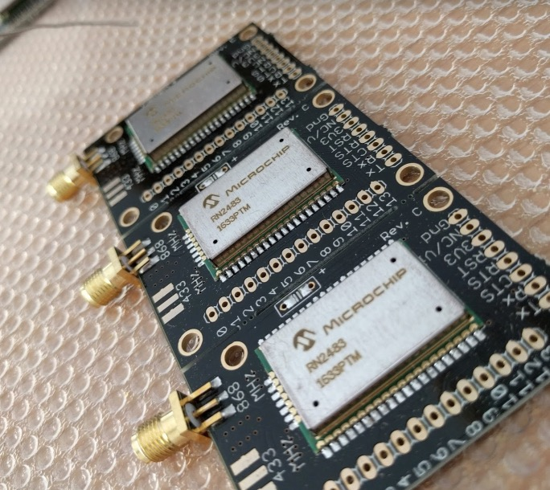

Low Cost
Photos by @gnz, CC-BY-SA
Node/transceiver: CHF 8.5
Gateway: ~CHF 250 (indoor)
Open source stack + ISM bands
Low CAPEX, almost negligible OPEX
Notes:
Current cheapest price for a node is ~8.5
Gateways start at ~250
open source software stack
unlicensed spectrum (ISM bands)

Slide 20
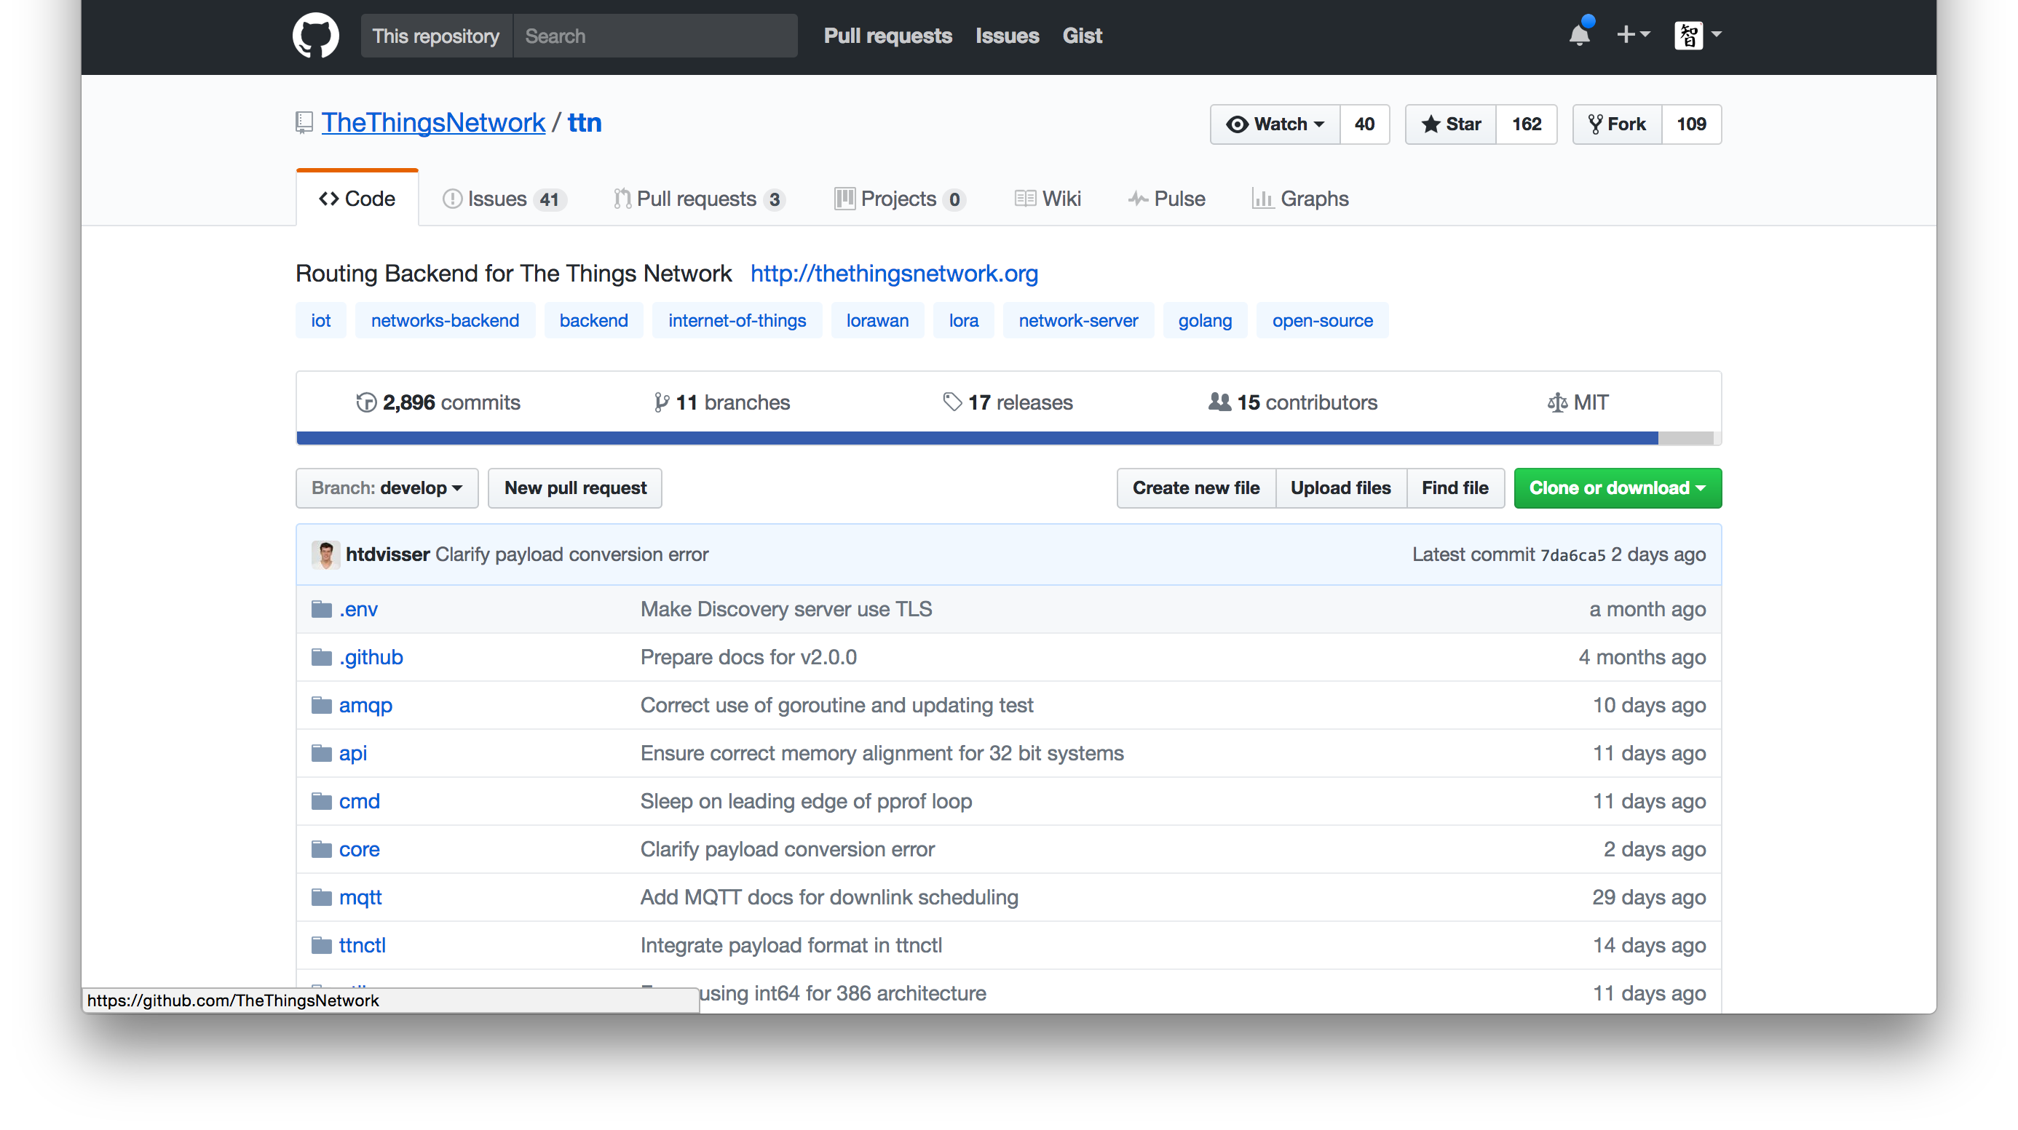
Free & Open Source Stack

Slide 21
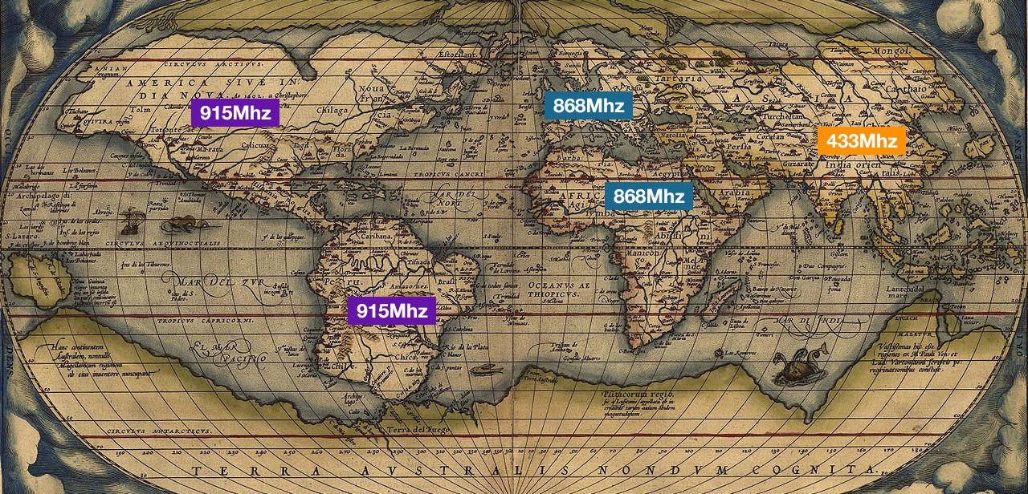
Unlicensed spectrum
Anyone can deploy a LoRaWAN network!

Slide 22
Low power
Class A
Class B
Class C
Always send, receive after send.
Time-synchronized receive windows.
Always-on receive mode.
Up to 10 years.
Not supported
Support not ready, but planned
Deep sleep: ~10 μA
TX ~40 mA
RX ~14 mA

Slide 23
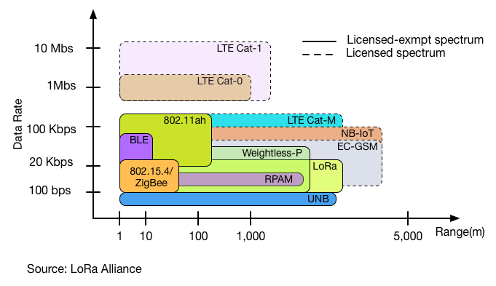

Slide 24
Limitations
Bandwidth
0.3 bps to 50 kbps
Payload size
51 bytes (DR0) 222 bytes (DR4)
Regulatory limits
1% Duty Cycle
Fair usage policy
30 seconds/day airtime 10 downlinks/day

